Slide 1
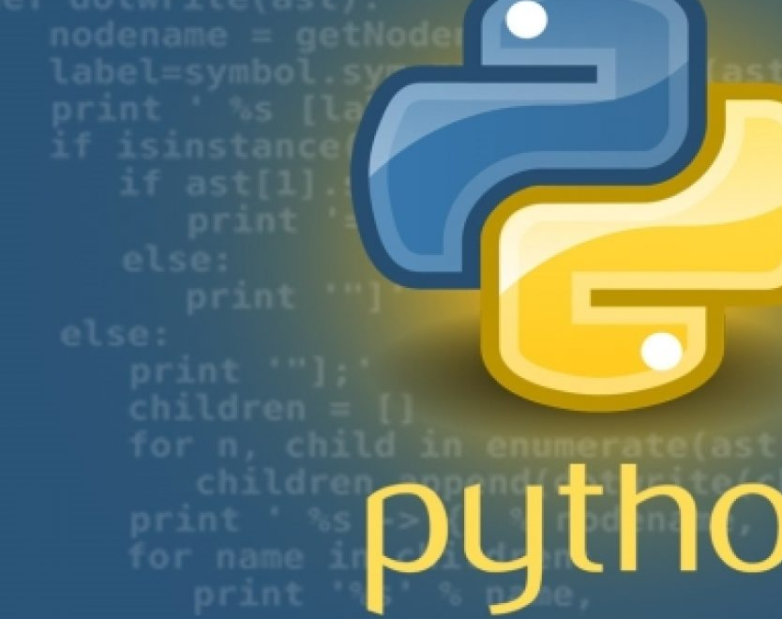
Introduction to python
.

Slide 2
Agenda
Installing python
Python basics
Data structure in python
Python functions
Object oriented programming
Numerical computing with NumPy
Data manipulation with pandas
Data visualization with Matplotlib

Slide 3
Introduction to python
Python is a popular programming language. It was created by Guido van Rossum, and released in 1991.
Interpreted high-level object-oriented dynamically-typed scripting language.
It is used for:
web development (server-side),
software development,
system scripting.

Slide 4
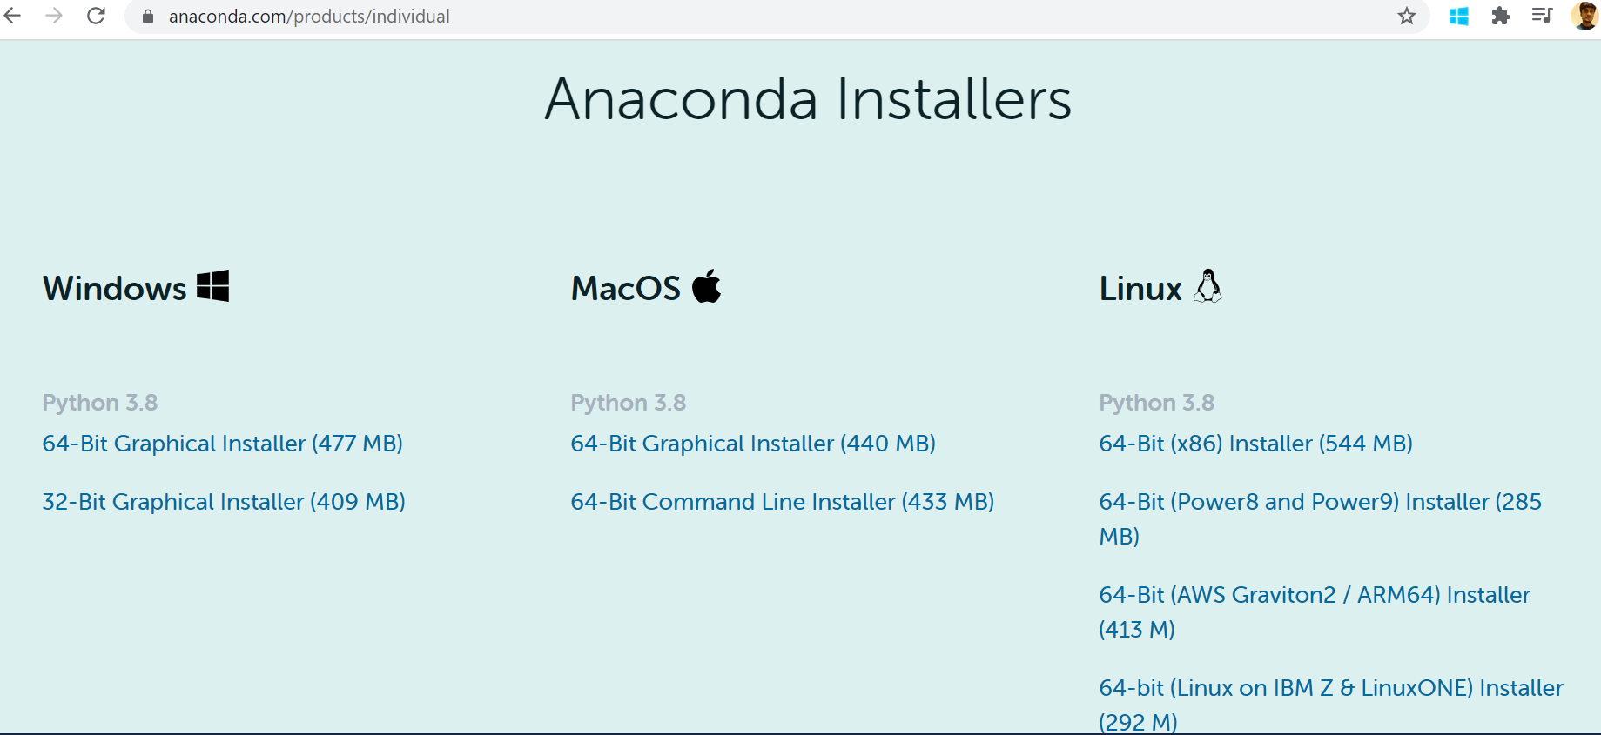
Installing IDE for Python

Slide 5
Intro to Jupyter Notebook
It is a browser based interpreter that allows us to interactively work with python.

Slide 6
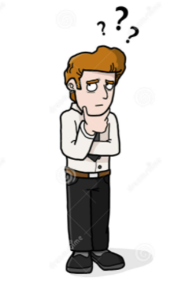
Variables in Python
How do I store the Data ?
e.g : Students in classroom
Baburao
Raju
Ghanshyam

Slide 7
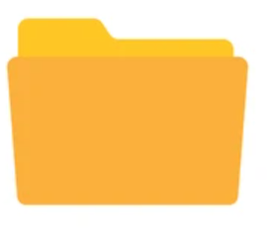
Variables in Python
Data/Values can be stored in temporary storage called variables.
→ Baburao → Raju → Ghanshyam

Slide 8
Data types in python
Every variable is associated with a data type.
Int (10,500)
Float (3.14,1.97)
Boolean(True,False)
String(“Baburao”,”raju”)

Slide 9
Operators in python
Arithmetic operators
Logical operators
Relational operators

Slide 10
Python Strings
Strings in python are surrounded by either single quotation marks, or double quotation marks.
'hello' is the same as "hello".

Slide 11
Data structures in Python
Tuple
Lists
Dictionary
Set

Slide 12
Lists
Lists are data structures that can hold a sequence of values of any data types. They are mutable (update-able).
Lists are indexed by integers.
To create a list, use square brackets:
my_list = ['A', 'B']
To add/update/delete an item, use index:
my_list.append('C') #adds at the end my_list[1] = 'D' #update my_list.pop(1) # removes

Slide 13
Tuples
Tuples are like lists in the sense that they can store a sequence of objects. The objects, again, can be of any type.
Tuples are faster than lists.
These collections are indexed by integers.
Tuples are immutable (non-update-able)
E.g: my_tuple = tuple() or my_tuple = 'f','m' or my_tuple = ('f', 'm')

Slide 14
Dictionaries
Dictionaries are used to store data values in key:value pairs.
A dictionary is a collection which is ordered*, changeable and does not allow duplicates.
Dictionaries are written with curly brackets, and have keys and values:
Example
thisdict = { "brand": "Ford", "model": "Mustang", "year": 1964 } print(thisdict)

Slide 15
Sets
Sets are used to store multiple items in a single variable.
A set is a collection which is both unordered and unindexed.
Sets are written with curly brackets.
Example
thisset = {"apple", "banana", "cherry"} print(thisset)

Slide 16
Flow control statements
Python supports the usual logical conditions from mathematics:
Equals: a == b
Not Equals: a != b
Less than: a < b
Less than or equal to: a <= b
Greater than: a > b
Greater than or equal to: a >= b

Slide 17
If…else
a = 200 b = 33 if b > a: print("b is greater than a") elif a == b: print("a and b are equal") else: print("a is greater than b")

Slide 18
Python Loops
while loops
for loops

Slide 19
while Loop
With the while loop we can execute a set of statements as long as a condition is true.
Example
Print i as long as i is less than 6:
i = 1 while i < 6: print(i) i += 1

Slide 20
The break Statement
With the break statement we can stop the loop even if the while condition is true:
Example
Exit the loop when i is 3:
i = 1 while i < 6: print(i) if i == 3: break i += 1

Slide 21
The continue Statement
With the continue statement we can stop the current iteration, and continue with the next:
Example
Continue to the next iteration if i is 3:
i = 0 while i < 6: i += 1 if i == 3: continue print(i)

Slide 22
The else Statement
With the else statement we can run a block of code once when the condition no longer is true:
Example
Print a message once the condition is false:
i = 1 while i < 6: print(i) i += 1 else: print("i is no longer less than 6")

Slide 23
Python For Loops
A for loop is used for iterating over a sequence (that is either a list, a tuple, a dictionary, a set, or a string).
This is less like the for keyword in other programming languages, and works more like an iterator method as found in other object-orientated programming languages.
With the for loop we can execute a set of statements, once for each item in a list, tuple, set etc.
Example
Print each fruit in a fruit list:
fruits = ["apple", "banana", "cherry"] for x in fruits: print(x)

Slide 24
The range() Function
To loop through a set of code a specified number of times, we can use the range() function,
The range() function returns a sequence of numbers, starting from 0 by default, and increments by 1 (by default), and ends at a specified number.
Example
Using the range() function:
for x in range(6): print(x)
for x in range(2, 6): print(x)
The range() function defaults to increment the sequence by 1, however it is possible to specify the increment value by adding a third parameter: range(2, 30, 3):
Example
Increment the sequence with 3 (default is 1):
for x in range(2, 30, 3): print(x)

Slide 25
Nested Loops
A nested loop is a loop inside a loop.
The "inner loop" will be executed one time for each iteration of the "outer loop":
Example
Print each adjective for every fruit:
adj = ["red", "big", "tasty"] fruits = ["apple", "banana", "cherry"] for x in adj: for y in fruits: print(x, y)

Slide 26
Functions
A function is a block of code which only runs when it is called.
You can pass data, known as parameters, into a function.
A function can return data as a result.
In Python a function is defined using the def keyword:
Example
def my_function(): print("Hello from a function")

Slide 27
Arguments
Information can be passed into functions as arguments.
Arguments are specified after the function name, inside the parentheses. You can add as many arguments as you want, just separate them with a comma.
The following example has a function with one argument (fname). When the function is called, we pass along a first name, which is used inside the function to print the full name:
Example
def my_function(fname): print(fname + " Refsnes") my_function("Emil") my_function("Tobias") my_function("Linus")

Slide 28
Object oriented progamming
Python is a multi-paradigm programming language. It supports different programming approaches.
One of the popular approaches to solve a programming problem is by creating objects. This is known as Object-Oriented Programming (OOP).
An object has two characteristics:
attributes
behavior
The concept of OOP in Python focuses on creating reusable code. This concept is also known as DRY (Don't Repeat Yourself).

Slide 29
Class
A class is a blueprint for the object.
We can think of class as a sketch of a parrot with labels. It contains all the details about the name, colors, size etc. Based on these descriptions, we can study about the parrot. Here, a parrot is an object.
The example for class of parrot can be :
class Parrot: pass
Here, we use the class keyword to define an empty class Parrot. From class, we construct instances. An instance is a specific object created from a particular class.

Slide 30
Object
An object (instance) is an instantiation of a class. When class is defined, only the description for the object is defined. Therefore, no memory or storage is allocated.
The example for object of parrot class can be:
obj = Parrot()
Here, obj is an object of class Parrot.

Slide 31
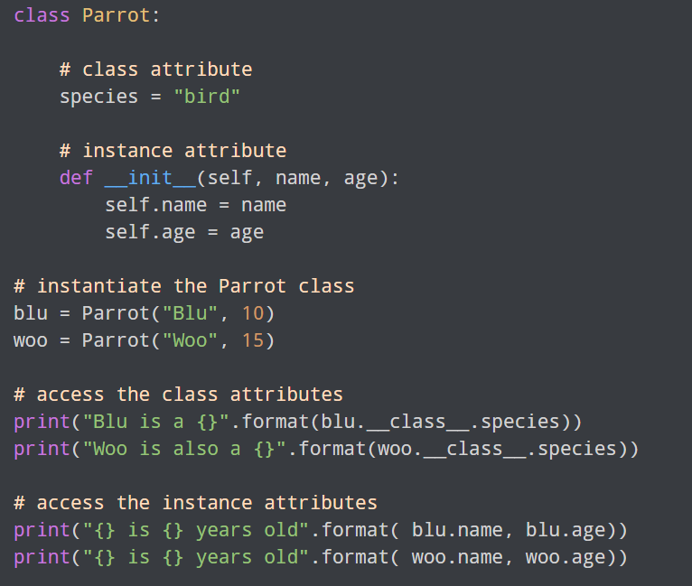
Creating Class and Object in Python

Slide 32
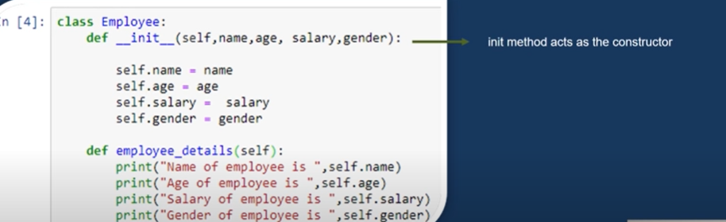
Creating a class with constructors

Slide 33
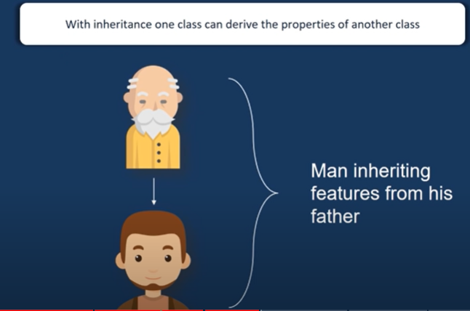
Inheritence in python

Slide 34
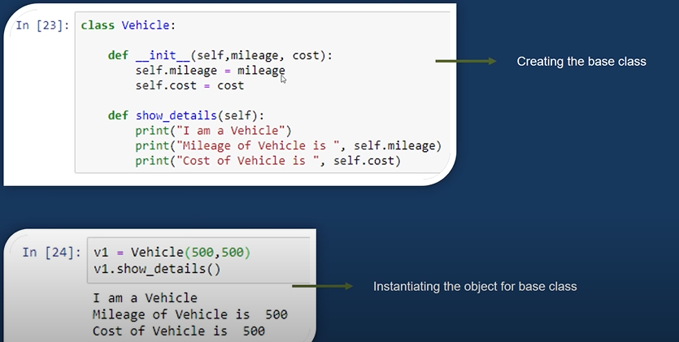
Inheritence example

Slide 35
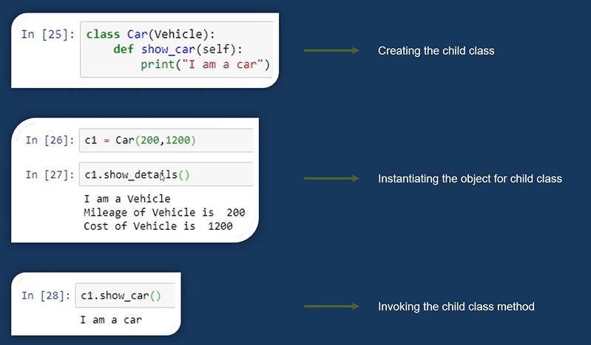
Inheritence example

Slide 36
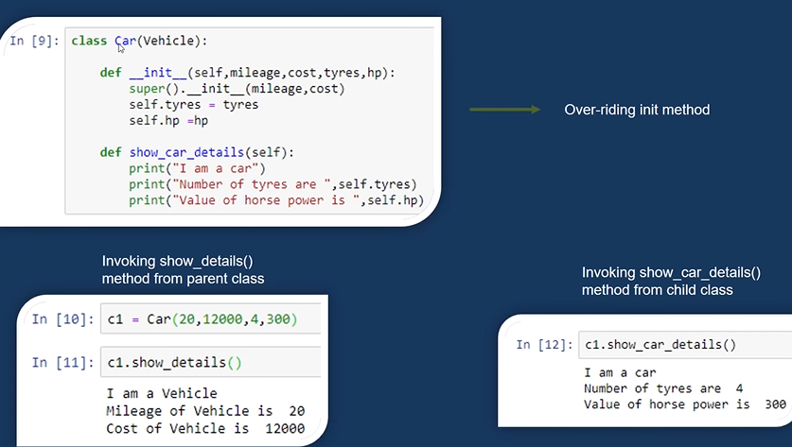
Overriding the init method

Slide 37
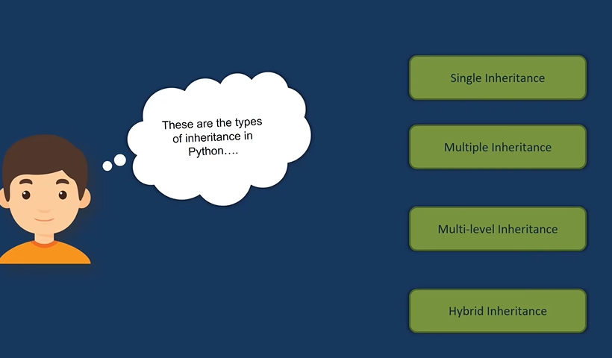
Types of inheritence

Slide 38
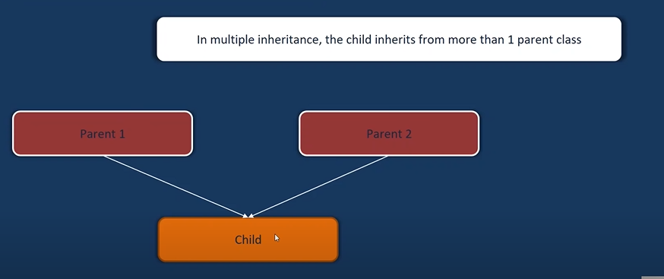
Multiple Inheritence

Slide 39
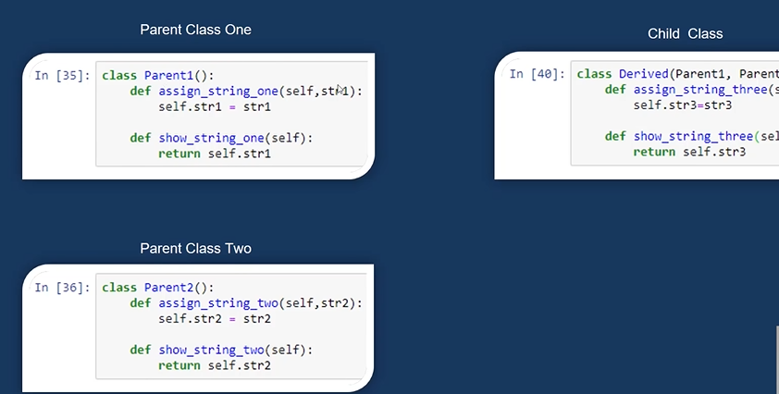
Multiple inheritance example

Slide 40
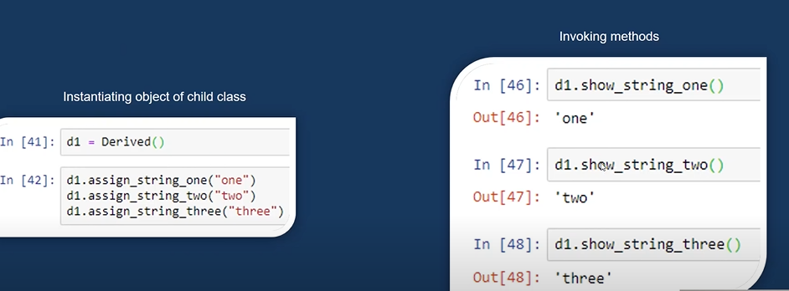
Example of multiple inheritence

Slide 41
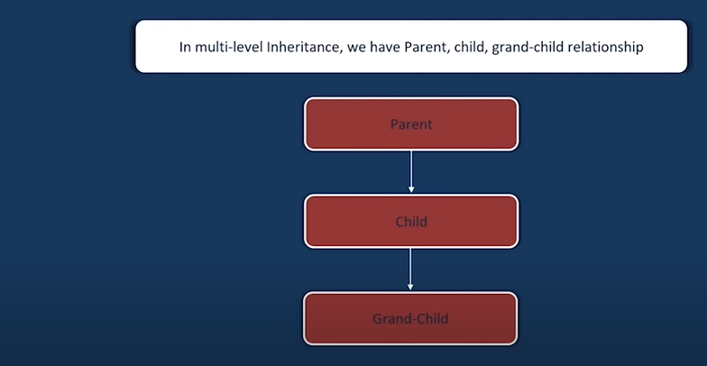
Multi level Inheritence

Slide 42
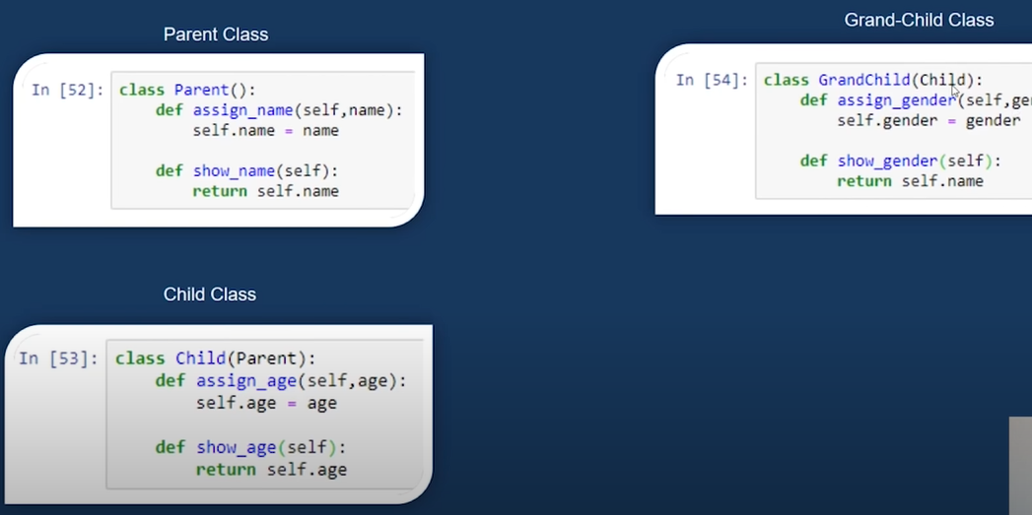
Example of multilevel inheritence

Slide 43
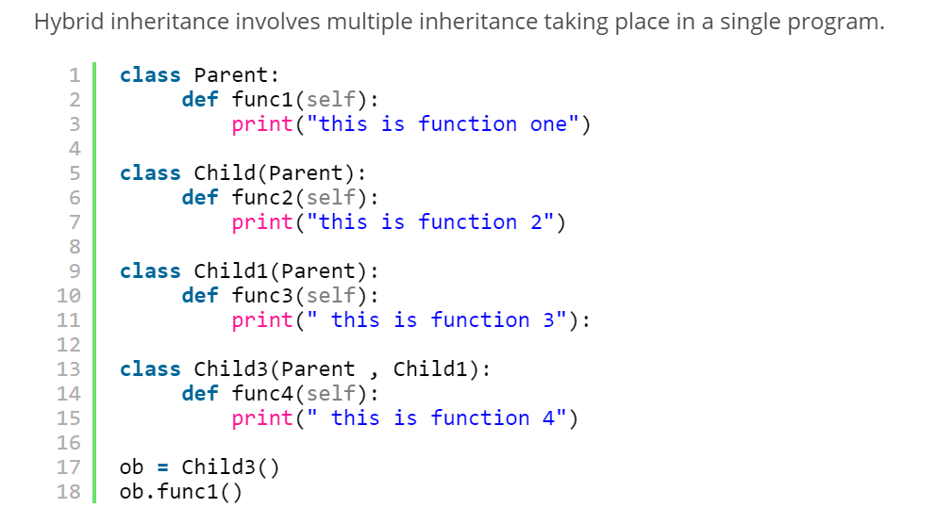
Hybrid inheritence

